Slide 1
Unit I Constitutional Underpinnings
The Creation of Government by and of the People?

Slide 2
Madison Speaks
“If men were angels, no government would be necessary. If angels were to govern men, neither external nor internal controls on government would be necessary. In framing a government which is to be administered by men over men, the great difficulty lies in this: you must first enable the government to control the governed; and in the next place oblige it to control itself.”
- James Madison, Federalist 51

Slide 3
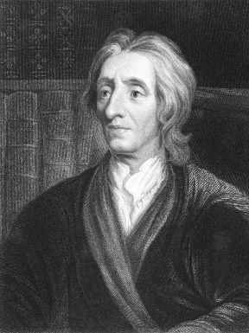
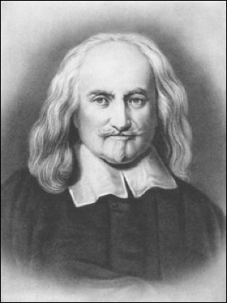
Madison Speaks
What are the fundamental differences between Locke & Hobbes ideals on government?
What common ideas do they have about government?
Locke’s View
Hobbes’ View
We Agree

Slide 4
Essential Question: How does the ideas of Constitutional republicanism work within modern American society to establish a balance system between government power and individual liberties?
Students can:
Decipher how Madisonian Model developed from Enlightened philosopher, Revolutionary rebellion, and political compromise
Agenda
Enlightenment connections
Deciphering a Declaration
Building a recipe for a democracy
Homework
Complete annotation of Articles of Confederation
Tasty Murican Democracy Recipe Due Monday

Slide 5
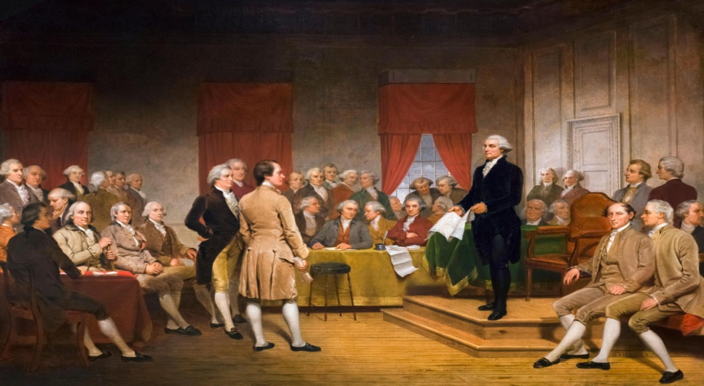

A Lego Constitution
  Select TWO of the following and explain how they help the Founding fathers define the idea of good governance in a Constitutional democracy.
  “Two Treatise of Government” by John Locke
  Tyrannical actions by the British government during the American revolution
  Declaration of Independence
What is good government?
Stopping object tyranny

Slide 6
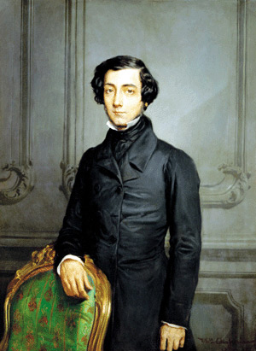
A Culture of American Politique
Political Culture: a set shared values or beliefs that are the bases for our political process.
AMERICA!
American Political Culture formed during colonization period.
Alex de Tocqueville’s “Democracy in America”
Westward expansion
Population – small independent farmers
No feudal Aristocracy
5 VALUES of AMERICAN POLITICAL CULTURE
Moral & Intellectual characteristics

Slide 7

Core Values of America
Core Values
Liberty
Individualism
Equalitarianism
Laissez faire
Popular sovereignty
Defining the exact meaning in the United States has encouraged political ideological differences.
Culture War: the ideological divide that some political scientist believe has lead to a political gridlock

Slide 8
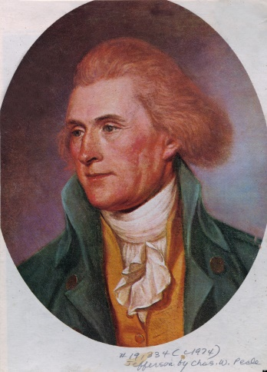
Jefferson’s Goal
"This was the object of the Declaration of Independence. Not to find out new principles, or new arguments, never before thought of, not merely to say things which had never been said before, but to place before mankind the common sense of the subject, in terms so plain and firm as to command their assent, and to justify ourselves in the independent stand we are compelled to take. Neither aiming at originality of principle or sentiment, not yet copied from any particular and previous writing, it was intended to be an expression of the American mind, and to give to that expression the proper tone and spirit called for by the occasion. All it's [sic] authority rests on the harmonizing sentiments of the day, whether expressed in conversation, letters, printed essays, or in the elementary books of public right, as Aristotle, Cicero, Locke, Sidney, & c."
—Thomas Jefferson to Henry Lee, May 8, 1825
1. Analyze the excerpt and explain the purpose of the Declaration of Independence according to Thomas Jefferson.

Slide 9
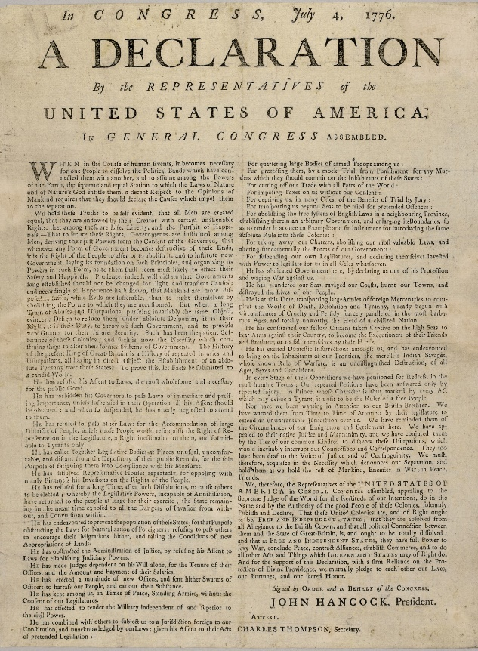
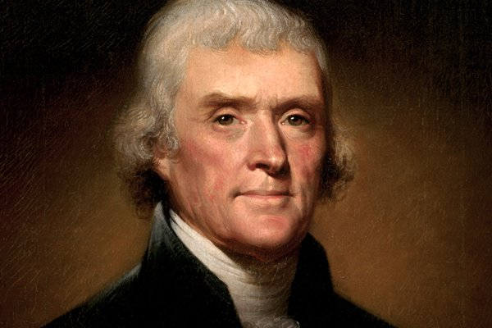
Jefferson Says What?
Declaration of Independence, 1776
Annotating a founding document
Prompt: How did the Declaration of Independence establish foundation of American Democracy, even though it is not a governing document?
Plagiarizing documents for governing ideas

Slide 10
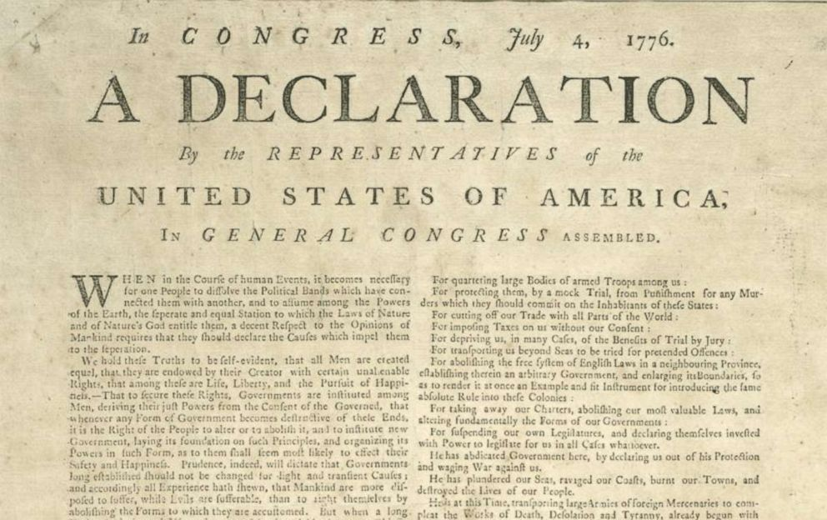
It’s too Late to Say Your Sorry
Contributing to a divorce between America and Great Britain
Self Government: Mayflower Compact, Continental Congress
Salutary Neglect
Taxation: No Taxation without Representation
Violation of opportunity: Navigation Acts, Proclamation of 1763
Tyranny: Closing state governments and courts
Violations of Rights: Quartering Act, Intolerable Acts
Enlightenment Political Philosophers

Slide 11
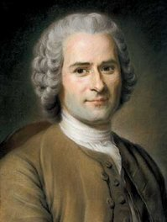
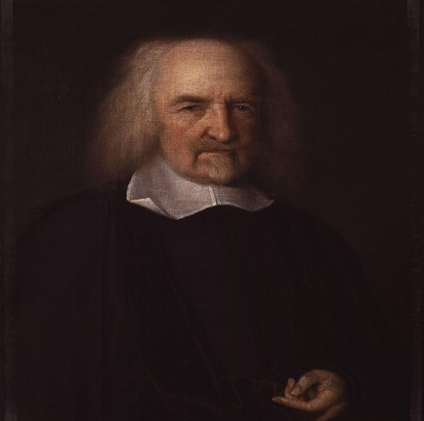
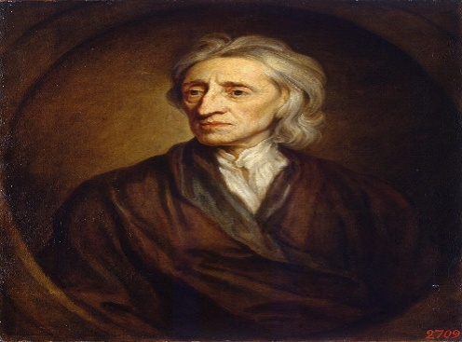
Enlightenment Principles
Age of Enlightenment Philosophy: The Development of the Social Contract – “People give consent to the govern in order to insure security”
People have natural rights
The people can overthrow the government if it does not work in their interest
People have natural rights
The people and government are bound to each other
People are dangerous
Government must control them

Slide 12
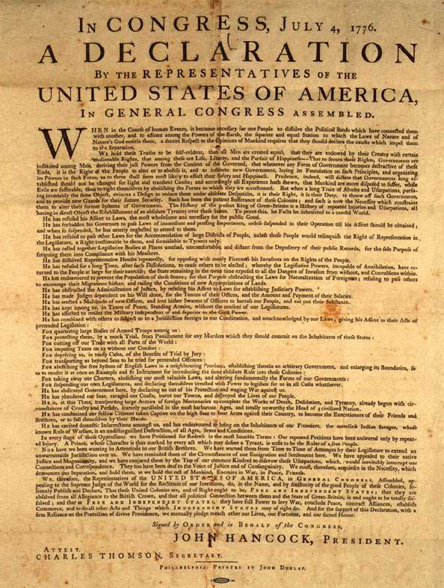
Defining the Parameters of the Declaration of Independence
The American Colonization experience:
Salutary Neglect leads to self government: Mayflower Compact, House of Burgesses, & Continental Congress
Colonization period engrains moral values of a future nation: Liberty, Equality, Opportunity, Laissez Faire, and Self government
English Tyrannical government: Stamp Act, Quartering Act, Proclamation of 1763, & Intolerable Act

Slide 13
A Recipe for the Foundations of Government
Declaration of Independence – a recipe for establishing American Democracy
Develop an annotated formula for American Democracy
Identify ingredients
  How did the Declaration of Independence further entrench the American identity?
  According to Thomas Jefferson, what are the principles of good government?
  According to Thomas Jefferson how has Britain committed tyranny and violated the social contract?
  How has Jefferson utilized Lockean philosophies of the enlightenment to support his claims?
American Democracy = American identity + Social Contract - Tyranny

Slide 14
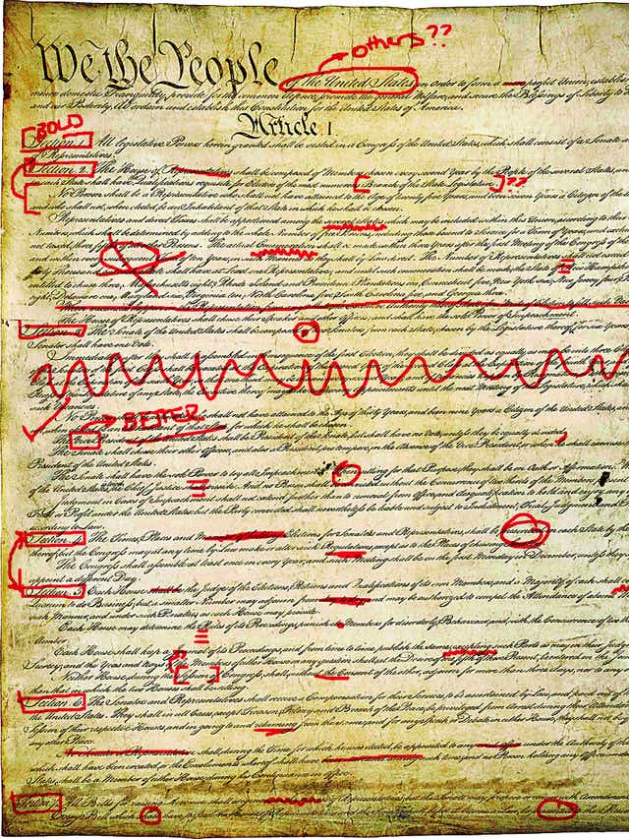
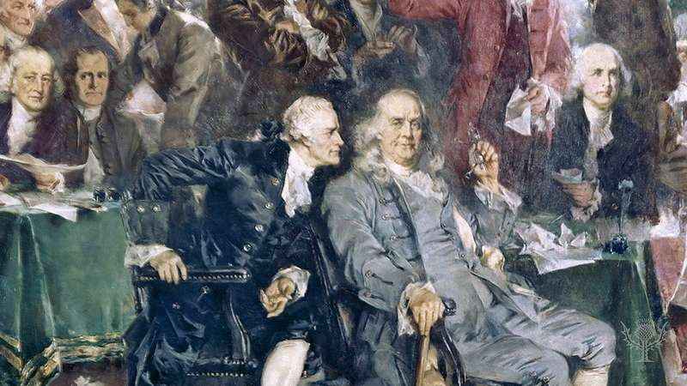
TASTY MURICAN DEMOCRACY
Recipe = Ingredients + Instructions + Warnings
Building American Democracy
What ingredients have the founders utilized in building a functional democracy?
What instructions did the founders use to build good governance?
What warnings have the founders come to believe are necessary to avoid a bad governance?
A pinch of monarchy definitely fouls the taste!
II say we add a dash of checks & balances to the recipe

Slide 15
Madison Speaks
"We hold these truths to be self-evident, that all men are created. equal, that they are endowed by their Creator with certain unalienable. Rights, that among these are Life, Liberty, and the pursuit of Happiness. - Thomas Jefferson
Locke’s Influence on the Declaration of Independence
Hobbes’ Influence on the Declaration of Independence
How does the Declaration of Independence further define our ideas about the Social Contact of governement

Slide 16
Essential Question: How does the ideas of Constitutional republicanism work within modern American society to establish a balance system between government power and individual liberties?
Students can:
Decipher how the Declaration of Independence established founding ideas for American Democracy
Decipher how Madisonian Model developed from Enlightened philosopher, Revolutionary rebellion, and political compromise
Agenda
Jefferson’s Purpose
The Formula of American Democracy
Setting forth a government of the people
Homework
Watch videos on the Articles of Confederation on AP Gov website
Constitutional Scavenger Hunt due Thursday

Slide 17
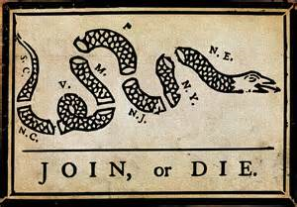
America’s First National Government
But if a long series of abuses, provocations and deceits, all in the same sense, make a conspiracy visible to the people, they cannot help sensing what is happening. It is quite natural then that the people should arise and attempt to put power into such hands as may secure for them the end for which the government was first established. – John Locke “Two Treatise on Government”
1776: Declaration of Independence
1781: Articles of Confederation:
Structure: unicameral legislature
Powers: deal with foreign diplomacy (ex. War & treaties) & Appoint officers

Slide 18
Essential Question: How does the ideas of Constitutional republicanism work within modern American society to establish a balance system between government power and individual liberties?
Students can:
Decipher how the Declaration of Independence established founding ideas for American Democracy
Decipher how Madisonian Model developed from Enlightened philosopher, Revolutionary rebellion, and political compromise
Agenda
What were the Founders Thinking?????
The AOC, a Decentralized Nightmare
Survivor Island
Homework
Constitutional Scavenger Hunt

Slide 19
Decentralizing Government
“the disorders which have arisen in these States. Good God! who besides a tory could have foreseen, or a Briton predicted them! were these people wiser than others, or did they judge of us from the corruption, and depravity of their
own hearts? The latter I am persuaded was the case, and that notwithstanding the boasted virtue of America, we are far gone in every thing ignoble and bad.”
- George Washington, 1786
Why did the founders believe it was appropriate to create a decentralize government through the ratification of the Articles of Confederation?
How did the Articles of Confederation alter the Founders views on democracy?

Slide 20
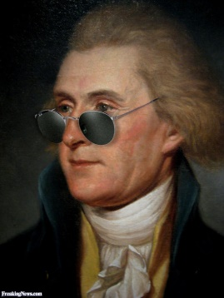
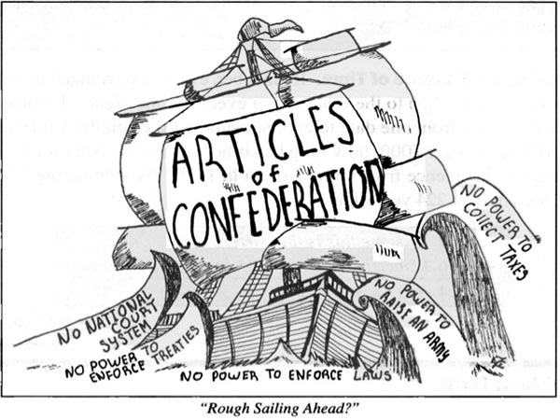
Factors in the AOC
“When the people fear the government, there is tyranny. When the government fears the people, there is liberty.
- Thomas Jefferson
Articles of Confederation 1781-1889
Alliance of states
Decentralized government
Limited government

Slide 21
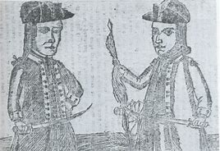
Rise to Rebellion
Shay’s Rebellion 1786-1787: Failure of the Articles of Confederation
What issues of the Articles of Confederation are brought to public awareness?
A return to the Revolution

Slide 22
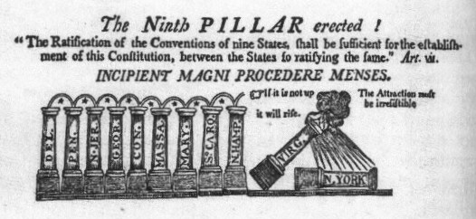
Challenges of a Young Nation
The United States post Revolutionary was in a state of crisis
National & state debt = $77 million
Shays’ Rebellion – 1786-87: National government can’t respond
Annapolis Convention - 1786: fixed issue with trade

Slide 23
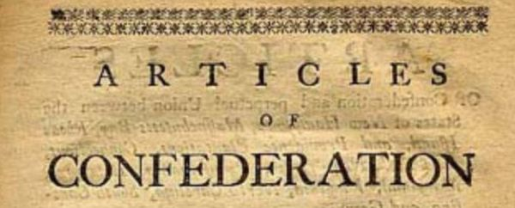
Structure of a Decentralize Gov.
Government structure
  Role of the state government
  Limitations placed on the states
  Responsibilities of the Confederation Congress
  Powers of the Confederation Congress
  How are delegates selected
  Voting process for laws and amendments
  Procedure by which Congress raises funds

Slide 24
Dissecting the Decentralize AOC
Dissecting the AOC
Confederation of States (Alliances)
Structure of Confederation government
State
Federal

Slide 25
Essential Question: How did the framers of the US Constitution redefine the concept of government and make a lasting legacy?
Student can:
  Evaluate the impact of tyranny and heritage impacted the development of the US Constitution
  Decipher whether Revolutionary principles have survived in our modern societies
  Construct an Amendment to streamline or Constitutional Democracy
Agenda
A Decentralized NIGHMARE
The Madisonian Model Built on Compromise
Achieving the ends of Government
Homework
Madisonian I.Q. Test
A Letter of Contrasting Government

Slide 26
Decentralizing Government
“the disorders which have arisen in these States. Good God! who besides a tory could have foreseen, or a Briton predicted them! were these people wiser than others, or did they judge of us from the corruption, and depravity of their
own hearts? The latter I am persuaded was the case, and that notwithstanding the boasted virtue of America, we are far gone in every thing ignoble and bad.”
- George Washington, 1786
Why did the founders believe it was appropriate to create a decentralize government through the ratification of the Articles of Confederation?
How did the Articles of Confederation alter the Founders views on democracy?

Slide 27
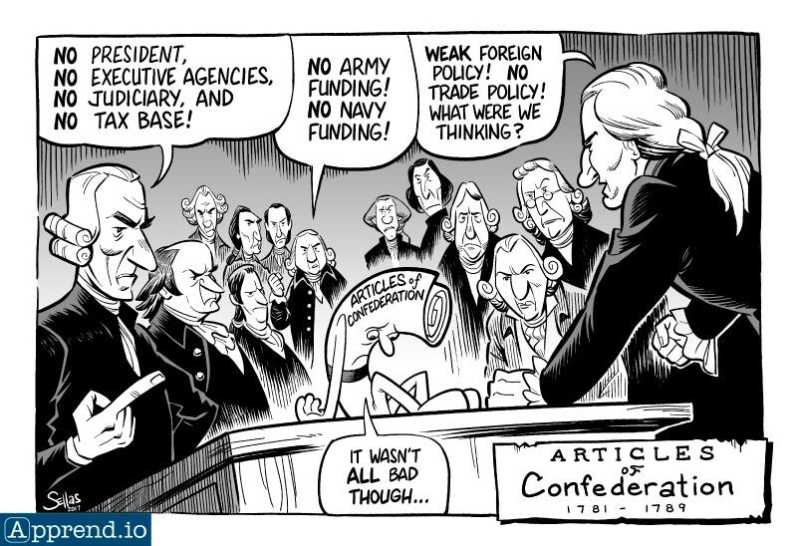
A Decentralized Nightmare
Articles of Confederation 1781-1789
Alliance of states
Decentralized government
Unicameral legislature with limited power
FAILURE
National Debt - $77 Million
Annapolis Convention - 1786
Shays’ Rebellion – 1786-87
Constitutional Convention 1787

Slide 28
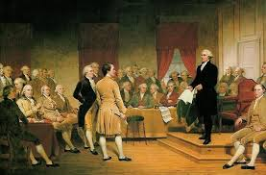
Repairs to a National Government
Constitutional Convention 1787 (Repair the Articles of Confederation)
Issue: Framing a government that could govern without abusing power
Articles of Confederation (To Weak)
British Monarchy & Parliament (Tyrannical)
New Government????

Slide 29
Plans of Government
Virginia Plan
New Jersey Plan
3 branches of government
bicameral legislature with representation by population
The legislature could regulate interstate trade, strike down laws deemed unconstitutional and use armed forces to enforce laws.
3 branches of government
Unicameral legislature with equal representation
The national government could levy taxes and import duties, regulate trade, and state laws would be subordinate to laws passed by the national legislature.
What are the difficulties the Founders’ face in the formation of a new Constitution?

Slide 30


Republicanism
The Great Compromise
Bicameral Legislature
Checks & Balances
Separation of Powers
Block the Tyranny of the Mob
House of Representatives
Representation by population
Reapportionment: every 10 years seats are reapportion based on census
Only directly elected body of government
Senate
Equal representation (2 per state)
Higher house
  6 year terms
  More special assigned powers
  Staggered terms

Slide 31
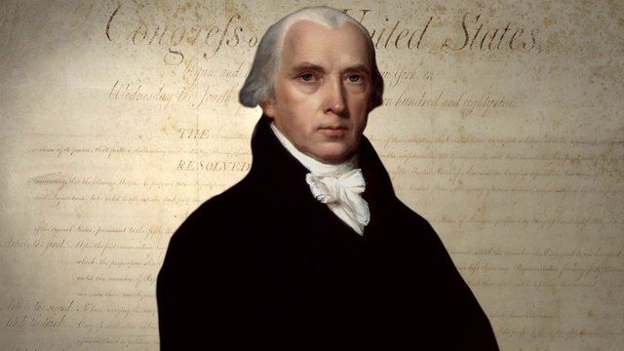
Madisonian Model of Government
“But the most common and durable source of factions has been the various and unequal distribution of property. Those who hold and those who are without property have ever formed distinct interests in society.”
- James Madison, Federalist 10
Madison Model of Government
Checks & Balances – Prevent government from abusing power
Separation of Powers – To empower government to govern while preventing tyranny
Prevent the Tyranny of the Mob – to ensure government doesn’t deny the rights of the minority

Slide 32
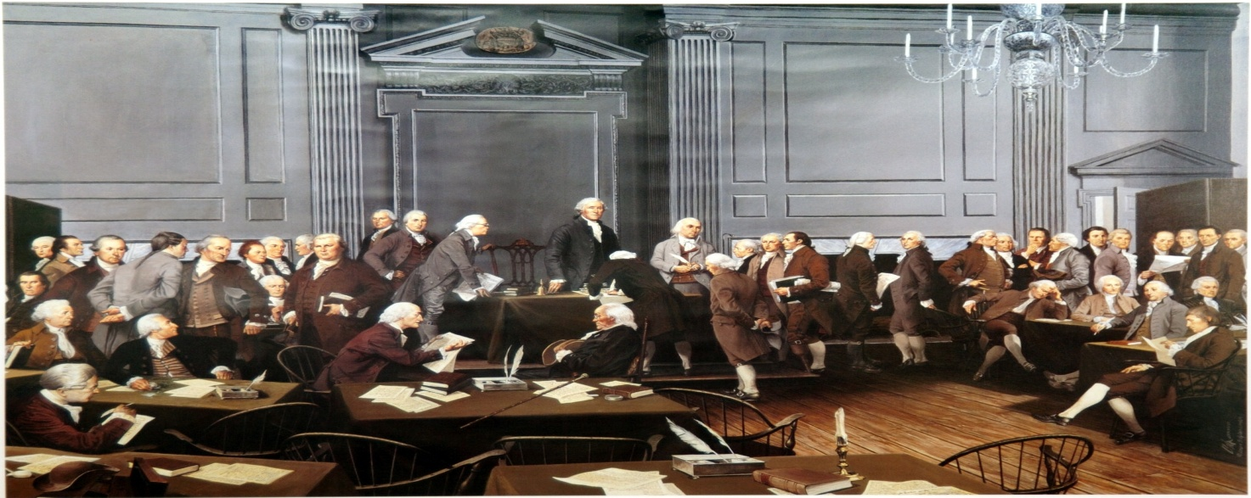
A Government of Compromise
Issues: representation, sectionalism, trade, & voting – distrust of the masses
Regulating trade
Fair representation
Voice of the people
Constitutional Compromises
3/5th Compromise – representation & sectional differences
Commerce Compromise – trade & sectional differences
Electoral Compromise – representation & voting

Slide 33
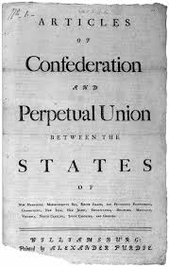
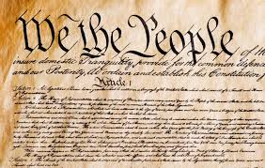
Contrasting Government’s
The U.S. Constitution was the repair for the Articles of Confederation
Structure of Government
Representation
State vs. National Government
The Powers to Govern

Slide 34
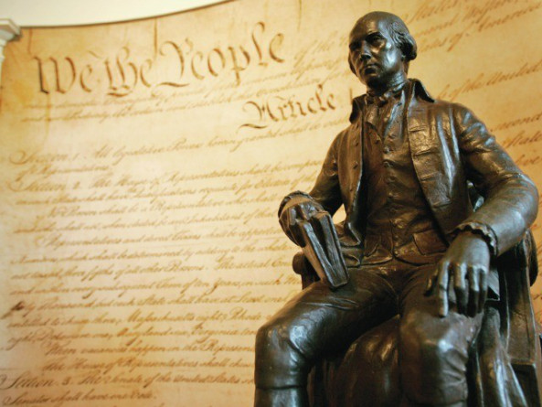
Madisonian Master Plan
What are the three objectives of the Madisonian Model of Government?
How did the Great Compromise uphold the ideas of the Madisonian Model of government?

Slide 35
Essential Question: How does the ideas of Constitutional republicanism work within modern American society to establish a balance system between government power and individual liberties?
Students can:
Decipher how Madisonian Model developed from Enlightened philosopher, Revolutionary rebellion, and political compromise
Evaluate the effectiveness of the U.S. Constitution to maintain the proper balance between the authority to govern and protection of personal liberties
Agenda
The Secret Dealings of AP Central
Constitutional principles
Deconstructing the ideas of government
Homework
Constitution FRQ (on a separate piece of paper)
Constitutional challenge journal review due Tuesday

Slide 36
Principles of the U.S. Constitution
The Backbone of the Madisonian Model of Government

Slide 37
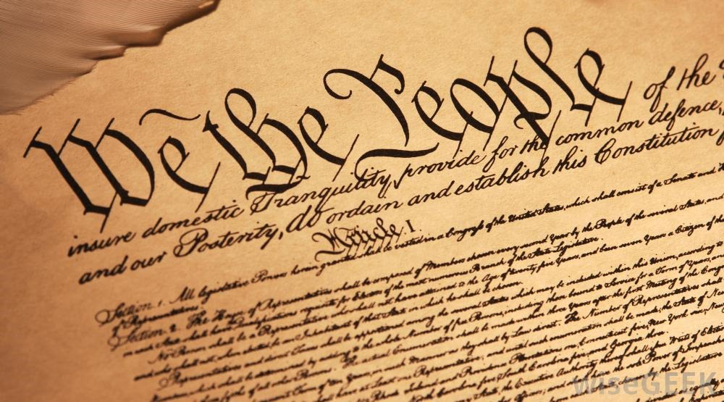
Principles of the Constitution
Popular Sovereignty – power of the people to govern themselves
Federalism – division of power between state & federal gov.
Separation of Powers– three branches of government: executive, legislative, & judiciary
Rule of law – laws apply to everybody even those that govern
Majority rule – decisions made by vote that requires 51% or in some case 75%
Checks & Balances – blocks to the power of government

Slide 38
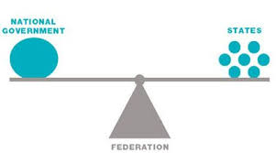
A Federal System
Federalism – a system of government the divides power to govern between national, states, and local levels of government
EXPRESSED POWERS
(National Government)
Military
Declare War
Print & Coin Money
Regulate interstate commerce
CONCURRENT POWERS
(Shared Powers Between National & State Governments)
Taxation
Lawmaking
Courts
RESERVE POWERS
(State Government)
Education
Marriage Laws
Regulate Elections
Regulate intrastate commerce

Slide 39
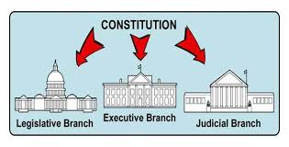
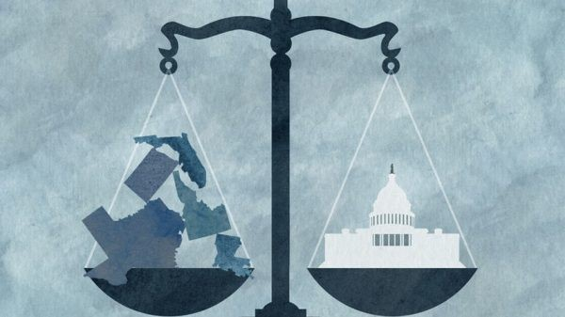
Separation of Powers
Separation of Powers
“In every government there are three sorts of power: the legislative; the executive in respect to things dependent on the law of nations; and the executive in regard to matters that depend on the civil law.
- Baron von Montesquieu, The Spirit of Laws
Three Branches of Government
Federalism

Slide 40
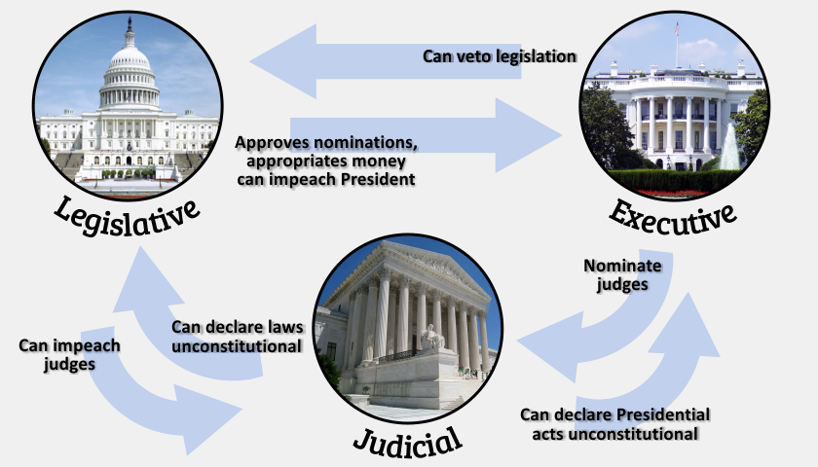
Checking the Power of Gov.
Checks & Balances
If men were angels, no government would be necessary. If angels were to govern men, neither external nor internal controls on government would be necessary. In framing a government which is to be administered by men over men, the great difficulty lies in this: you must first enable the government to control the governed; and in the next place oblige it to control itself.
- James Madison, Federalist 51

Slide 41
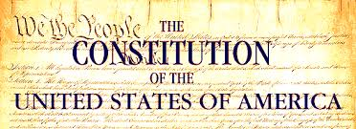
A Government of the People
Popular Sovereignty: Direct & Indirect Elections
Majority Rules – (some cases supermajorities)
Rule of Law – check on the government (impeachment)

Slide 42
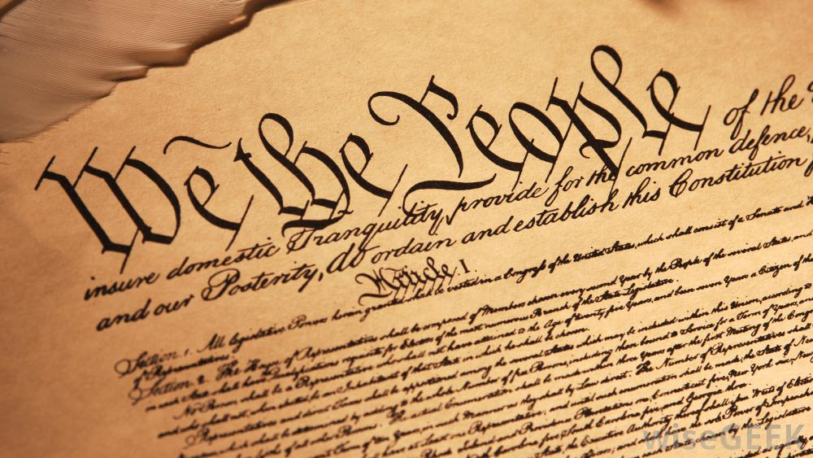
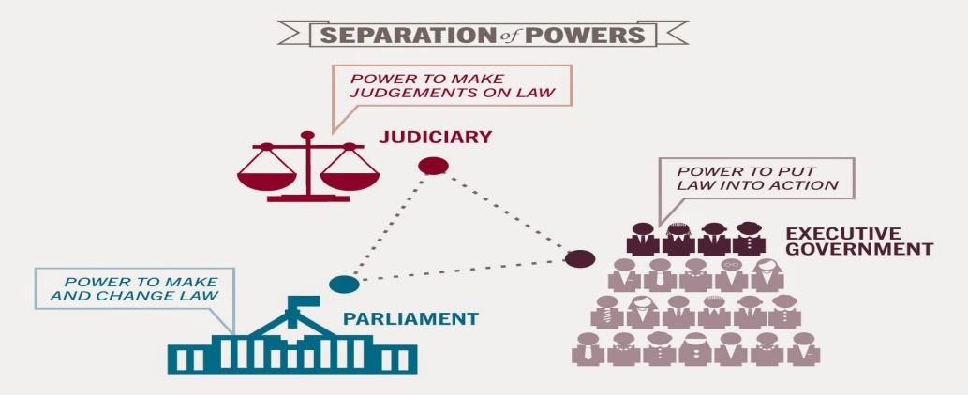
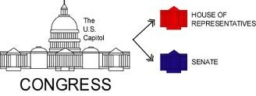
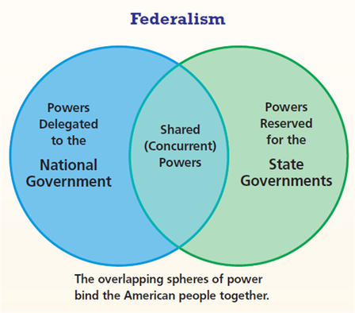
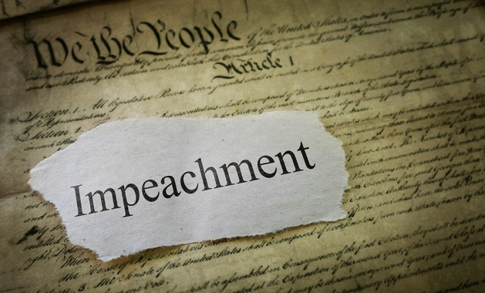
The Principles of Madisonian Model
Separation of Powers
Three Branches
Bicameralism
House passes articles of impeachment
Senate jury for impeachment trial
Federalism

Slide 43
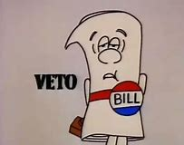
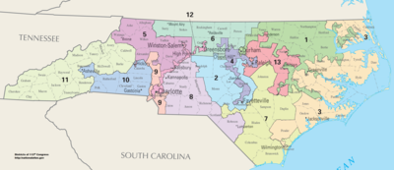
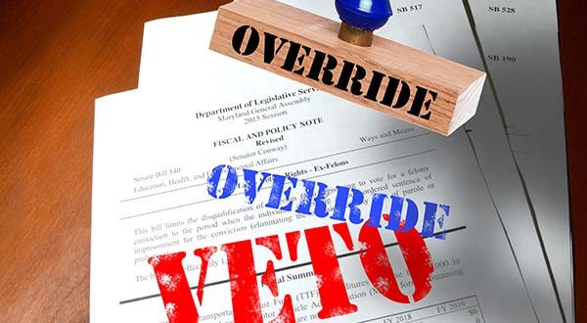
The Principles of Madisonian Model
Checks & Balances
Presidential Veto
House f Representative Elections every 2 years
Congressional Override

Slide 44

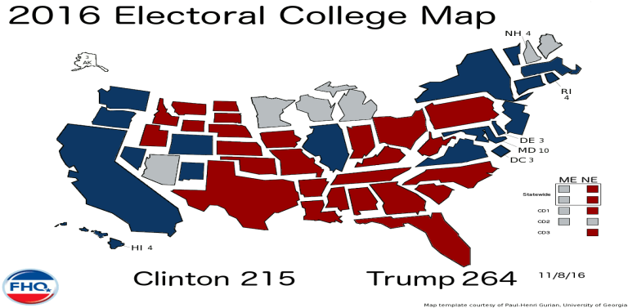
The Principles of Madisonian Model
Popular sovereignty
Representative Democracy
blocking the tyranny of the Mob
Electoral College

Slide 45
Essential Question: How did the Founding Fathers develop the idea of the republic and allow it the flexibility to adapt modern society?
Students can:
Decipher how Madisonian Model developed from Enlightened philosopher, Revolutionary rebellion, and political compromise
Evaluate the effectiveness of the U.S. Constitution to maintain the proper balance between the authority to govern and protection of personal liberties
Agenda
A Madisonian Model of Government
Those Freakin FRQs
FRQing in APGOPO
Homework
Constitutional Republic FRQ Concept Analysis

Slide 46
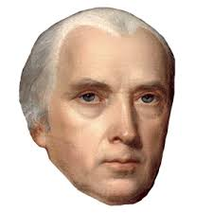
The Madisonian Model
The first question that offers itself is, whether the general form and aspect of the government be strictly republican. It is evident that no other form would be reconcilable with the genius of the people of America; with the fundamental principles of the Revolution; or with that honorable determination which animates every votary of freedom, to rest all our political experiments on the capacity of mankind for self-government. If the plan of the convention, therefore, be found to depart from the republican character, its advocates must abandon it as no longer defensible.
- James Madison, Federalist 39, January 16, 1788
James Freakin Madison – Father of the Constitution
The Constitution is built on the idea of the Madisonian Model of Government
How did the framers of the Constitution ensure they build government that could govern without promoting tyrannical power?
Explain TWO changes that were made in the U.S, Constitution to repair problems with the Articles of Confederation.

Slide 47



Breaking Down the Freakin SAQ
A Secret to success in AP GOV
Yeah!!!

Slide 48
FRQ Type I – Concept Application
Since 2008 the Alliance Defending Freedom, a conservative Christian interest group, has promoted an annual event known as Pulpit Freedom Sunday. On this occasion, pastors are encouraged to challenge a provision of the tax law known as the Johnson Amendment, which prohibits political activity by certain nonprofit organizations, including religious organizations. While the Johnson Amendment does not restrict religious leaders from speaking out regarding social issues, it does prohibit them from contributing money to political campaigns or speaking out in favor or against candidates running for political office. On Pulpit Freedom Sunday, as an act of civil disobedience, pastors and religious leaders preach openly about the moral qualifications of candidates seeking office.
After reading the scenario, please respond to A, B, and C below.
Describe an action Congress could take to address the concerns of the interest group in the scenario.
In the context of the scenario, explain how partisan divisions could prevent the action described in part A.
Explain why the Alliance Defending Freedom might argue that their constitutional rights are threatened by the Johnson Amendment.

Slide 49
FRQ Type II – Quantitative Analysis
2. Use the bar graph to answer the following questions.
Identify the political affiliation of people who are most likely to believe elected officials should compromise.
Describe the difference between Democrats and Republicans on their attitudes of whether government officials should stick to their principles, based on the data in the bar graph.
Explain how the data in the bar graph could influence how a Republican candidate would shift his or her campaign positions after securing the Republican nomination for president.
Explain how the data in the bar graph could affect policy making interactions between the president and Congress

Slide 50
FRQ Type III – Supreme Court Comparison
In the 1950s, Pete Hernandez, a Mexican American agricultural worker, was found guilty of murder and sentenced to life in prison by an all-white jury in Jackson County, Texas. Hernandez’s defense claimed that people of Mexican ancestry had been discriminated against in Jackson County. They pointed to the fact that no person of Mexican ancestry had served on a jury in 25 years and that the Jackson County Courthouse itself practiced segregation in its facilities. The five jury commissioners, who selected the members of the grand jury, testified under oath that they selected jurors based only on their qualifications and did not consider race or national origin in their decisions. In the ensuing case, Hernandez v. Texas (1954), the Supreme Court unanimously ruled in favor of Hernandez, deciding that evidence of discrimination against Mexican Americans existed in Jackson County and that the Constitution prohibits such discrimination.
Based on the information above, respond to the following questions.
Identify the clause in the Fourteenth Amendment that was used as the basis for the decision in both Brown v. Board of Education (1954) and Hernandez v. Texas (1954).
Explain how the facts in both Brown v. Board of Education and Hernandez v. Texas led to a similar decision in both cases.
C. Explain how an interest group could use the decision in Hernandez v. Texas to advance its agenda.
15 require Supreme Court Cases

Slide 51
FRQ - Steps to Success
Step 1 – Analysis
The first three FRQs will have a stimulus which critical to respond understanding what is being asked. (Strip the stimulus for important clues
The Question - highlight key words within the question and simplify what the question is asking
Action Verbs (Qualify): identify, describe, explain, and analyze
Step 2 – Plan
Quick plan each part (A, B, C, etc . . .) – NO REPEATING IDEAS – one time only
Bulleted examples (be factual – Great Compromise, 1st Amendment
Step 3 – Write – use complete sentences and paragraphs (bulleted points or outlines DO NOT earn points)
Step 4 – Proofread – make sure you have no glaring errors (correct if you do – don’t re-write the whole thing), and you have met the guidelines of the action verbs with an example

Slide 52
Deconstructing FRQs
After the Constitutional Convention Federalists and Anti-Federalists debated over whether the states should ratify the U.S. Constitution. Pseudo-names, such as Publius, Brutus, and Federal Farmer, presented argumentative tracks over whether the Constitution created a a balanced government; meaning did it properly give the national government the authority to govern without creating tyrannical government. Each side explain how the new Constitution repaired the failures of the Articles of Confederation and evaluated whether these promoted democracy or inhibited it. The ratification debate was especially important because Americans had not forgotten their experience under the authority of the British monarchy and give us insight as how-to potential interpret the Constitution for our modern times.
After reading the scenario, please respond to A, B, and C below.
In context of the excerpt, explain ONE way that the Anti-federalist would argue that the U.S. Constitution created the opportunity for the national government to become to powerful.
One of the major focuses of the debate over the original Constitution was how it could maintain liberty and the security of the people. Explain ONE way the Constitution was designed to met this challenge?
The Constitution was designed to outlast those that framed it. Explain how the Constitution, established in 1789, has been able to govern America through modern changes.

Slide 53
Winning the FRQ Race
Describe a major difference between a representative democracy and direct participatory democracy.
Explain ONE reason why the founders selected a decentralized government of the Articles of Confederation as their first attempt a government of the people.
Explain two major ways the Constitution repaired weaknesses of the Articles of Confederation.
In response to Jefferson’s quote above, how did the founders establish a government that had the authority to govern but also had protections against tyranny.
Describe ONE way that the Constitution can be consider a living document.
Must include each democracy works differently (rep. Dem. elects people to govern for us vs. all citizens debate and vote on laws)
Must explain the reason support with factual evidence
Must explain – National government can tax (DOES NOT explain how this is a repair to the AOC)
Must give a constitutional principle and explain it
Must explain how the constitution can be adapted to fit a modern society (amendments without explaining is an incomplete answer)

Slide 54
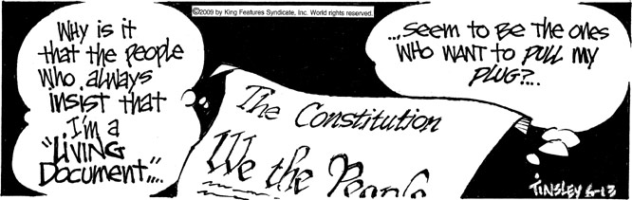
A Living Document
Formal Change
Within the Constitution
Constitutional Amendment
Two Step Process
Proposal – 2/3rds vote in both house of Congress or 2/3rds vote by states in a national convention
Ratification – 3/4th vote of state legislation or 3/4th vote by states at a national convention

Slide 55
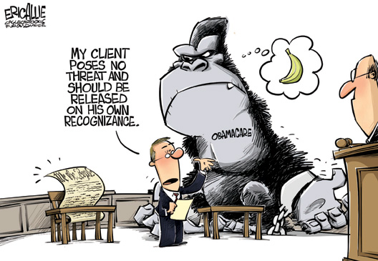
A Living Document
Informal Changes
to the Constitution
Supreme Court decisions - precedent
Tradition – Political parties
Interpretation: Take Care of Clause – executive orders
Flexible Constitution
Necessary and Proper Clause – implied powers through expanding enumerated powers (Air Force, Regulation of Pollution, National Bank)
Interstate Commerce Clause – regulate trade allows government to limit state powers (Healthcare, Segregations)

Slide 56
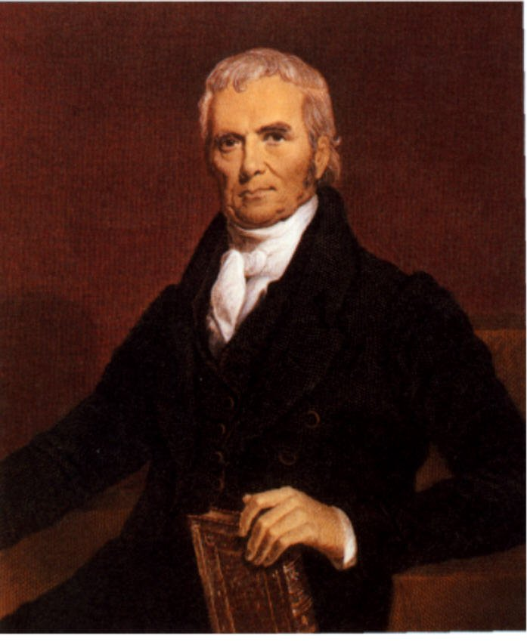
Marbury v. Madison (informal amending)
Marshall Law
"It is emphatically the province and duty of the judicial department to say what the law is.”
- Justice John Marshall, Marbury v. Madison 1803
The Constitution is a Living Document
Interpretation – Judicial Review
The Constitution is the law of the land
The court’s job is to interpret the Constitution
Therefore they can declare laws unconstitutional

Slide 57

Constitutional Band-aide
Complete contrast between the Articles of Confederation and the U.S. Constitution
Abating Fears
How did adjustments to the Constitution grant government the authority to govern without creating tyranny? Consider the following:
Standing Military
Taxation
Centralized Government Structure
Executive Branch of Government
2. Why will some believe that the U.S. Constitution creates a government that will be tyrannical?
Is limited government possible?

Slide 58
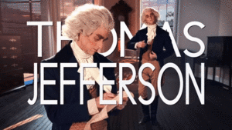
TJ’s Test
That to secure these rights, Governments are instituted among Men, deriving their just powers from the consent of the governed, That whenever any Form of Government becomes destructive of these ends, it is the Right of the People to alter or to abolish it, and to institute new Government, laying its foundation on such principles and organizing its powers in such form, as to them shall seem most likely to effect their Safety and Happiness.
- Thomas Jefferson, Declaration of Independence, 1776
Evaluate how effectively the U.S. Constitution follows the ideas established by Thomas Jefferson in the Declaration of Independence.
Explain ONE way that the Constitution upholds the ideas of the Declaration of Independence.
Explain ONE way that the Constitution fails the ideas of the Declaration of Independence.

Slide 59

Constitutional Challenges
Constitutional Challenge
Prompt: How effective is the U.S. Constitution in maintaining a proper balance between government authority and the protection of personal liberty?
War on Terrorism

Slide 60
Recipe for Good Government
Rubric:
0-2 pts. Cooking instructions: Using recipe references to explain how good government is formed and incorporates the core values of all Americans.
0-3 pts. Document use: Using the documents, framers’ experiences, and Enlightened ideas to demonstrate how the founders utilized a variety of sources to build the United States government.
0-3 pts. Content: Demonstrates the Madisonian Model and the American core values that we all believed
0-2 pts. Cooperation: Partners work equally to complete research and develop the Constitutional recipe for good government

Slide 61

Constitutional Principles on Trial
How effective is the U.S. Constitution at governing our nation in modern times?
What principle of the Constitution was involved?

Slide 62
Essential Question: How does the ideas of Constitutional republicanism work within modern American society to establish a balance system between government power and individual liberties?
Students can:
Determine how the Madisonian Model of Government developed from a variety of influencers
Demonstrate how the Madisonian Model of Government achieves its three premises for good government
Decipher the pros and cons of a Constitutional Republic through interpretation of the Federalists and Anti-federalists’ arguments
Agenda
Pillars of the Madisonian Model
Ratification debate
To be a Fed or Anti-fed
Homework
Annotation of Federalists’ & Anti-federalists’ Arguments

Slide 63
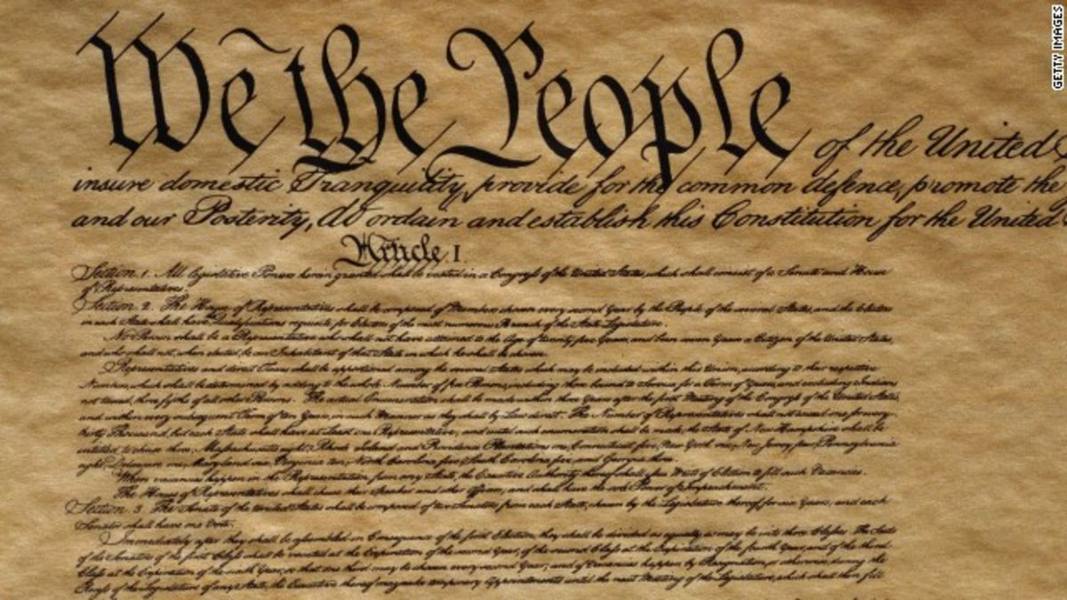

Assessing your Madisonian I.Q.
Construct a list of the different ways in which the U.S. Constitution incorporated the three objectives of the Madisonian Model
Checks & Balances
Separation of Powers
Blocking the Tyranny of the Mob

Slide 64
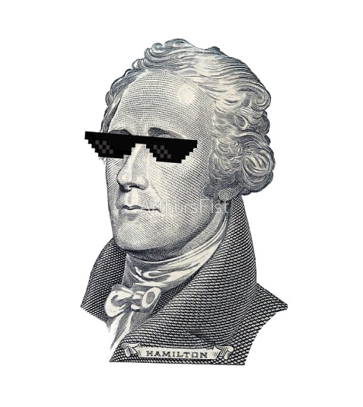
Constitution Convention
Ratification debate: Federalists vs. Anti-federalists
Factors for debate:
The Ratification of the Conventions of nine States, shall be sufficient for the Establishment of this Constitution between the States so ratifying the Same.
- U.S. Constitution, Article VII
State vs. Federal Power
Protection of individual liberties
U.S. Constitution Acceptance or Rejection

Slide 65
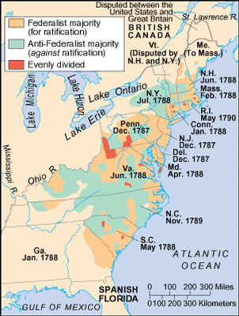
Demographics of Ratification
Anti-federalist: agrarian society
Federalist: urban & industrial society
Factors in Federalist victory:
Bill of Rights Compromise
The Articles of Confederation were a failed government
No better alternative

Slide 66
Ratification Debate
Quote 1: “The president serves a 4-year term and can be removed for office through the impeachment process. In addition, Congress and the Judiciary are given powers which allow them to balance and check the President’s actions. Thus, the President will not be like a monarch.”
Quote 2: “The national government’s powers are too broadly and poorly defined, and the powers of the individual states are left unclear.”
Quote 3: In a small republic such as the individual states, one group can dominate government and take action to benefit only that group. In a large extended republic it will be difficult for one group to control, and thus the public good will be better protected.
Quote 4: The national government is limited to only those powers granted to it. All powers not delegated to it remain in the hands of the individual states.

Slide 67

Annotating Federalists & Anti-Federalists Perspective
Prompt: How effective is the U.S. Constitution in maintaining a proper balance between government authority and the protection of personal liberty?
A summary of each reading (thesis, support evidence)
Ways the articles, clauses, powers, and offices of the Constitution support the Federalists’ or Anti-federalists’ arguments
  Identify relevant connections (principles, clauses, American identity etc.)
  Examples from today’s world that relate
  Identify quotes, facts, and concepts as support

Slide 68

Ratification Clarity
Federalists v. Anti-federalists ratification debate
Prompt: How effective is the U.S. Constitution in maintaining a proper balance between government authority and the protection of personal liberty?
Annotating a ratification argument
Federalists’ Papers 10 and 51
2. Anti-federalists’ Papers Brutus 1 and 74

Slide 69
Essential Question: How does the ideas of Constitutional republicanism work within modern American society to establish a balance system between government power and individual liberties?
Students can:
Decipher how Madisonian Model developed from Enlightened philosopher, Revolutionary rebellion, and political compromise
Evaluate the effectiveness of the U.S. Constitution to maintain the proper balance between the authority to govern and protection of personal liberties
Agenda
Fed or Anti-fed, That is the question
A Recipe for American Democracy
Homework:
- Federalist 2 Debate on Immigration (AP Gov website – Foundations of Democracy Link)

Slide 70


The Founders said WHAT?
Summarize the main ideas of the Federalist & Anti-federalist papers
Guidelines:
POV: Who wrote?
Argument purpose: what is the focus of the argument
Evidence: what parts or ideas of the Constitution are utilized to support the author’s purpose?
Samples of the argument

Slide 71

FED 2 – a falsehood of the founders
E Pluribus Unum – Out of many, ONE
How effective can the republic, created by the U.S. Constitution, govern a pluralist society, such as America?
Federalist Paper #2 argument
Sanford Levison’ s argument
Potential solutions offered by the U.S. Constitution

Slide 72
Essential Question: How does the ideas of Constitutional republicanism work within modern American society to establish a balance system between government power and individual liberties?
Students can:
Determine how the Madisonian Model of Government developed from a variety of influencers
Demonstrate how the Madisonian Model of Government achieves its three premises for good government
Decipher the pros and cons of a Constitutional Republic through interpretation of the Federalists and Anti-federalists’ arguments
Agenda
Federalist 10 Defense
Etu Brute
Bullocks to Brutus
Homework
Ratification FRQ
Ratification Rap – Due 9/15
Unit I part A Assessment – Thursday 9/17

Slide 73
FED 2 – a falsehood of the founders
E Pluribus Unum – Out of many, ONE
How effective can the republic, created by the U.S. Constitution, govern a pluralist society, such as America?
Federalist Paper #10 argument
Potential solutions offered by the U.S. Constitution

Slide 74
Ratification Debate
Federalists
Anti-federalists
Document’s Thesis:
Support facts
Modern examples
Federalists: James Madison, Alexander Hamilton, & John Jay
Document’s Thesis:
Support facts
Modern examples
Anti-federalists: Robert Yates, John Lansing, and Richard Henry Lee

Slide 75
Limited gov. or Tyranny
Constitutional Ratification Debate
Constitution | Federalist | Anti-federalist
1. Presidency
2. Federalism
3. Bill of Rights
4. Checks & Balances
5. Taxation
6. Courts
7. Standing Military

Slide 76
Brutus beat down on the Constitution
Claim: “It is true this government(Constitution) is limited to certain objects, or to speak more properly, some small degree of power is still left to the states, but little attention to the powers vested in the general government, will convince a candid man, that if it is capable of being executed, all the is reserved for the individual states must very soon be annihilated, except so far as they are barely necessary to the organization of the general government.”
- Brutus 1, 1787
Ideas: Federalism, enumerated powers vs. reserve powers, (ex. Standing military, taxation), Supreme Court, Necessary and Proper clause, Supremacy Clause
Debate Planner: Argument Antifederalist
Argument – the Constitution created a national government that will destroy states’ sovereignty by granting it enumerated powers and supremacy over the state
Taxations will leave nothing for the states
Necessary & proper clause allows Congress to repeal state laws

Slide 77

Et tu Brute
Claim: “But if, on the one hand, this form of government contains principles that will lead to the subversion of liberty – if it tends to establish despotism, or, what is worse, a tyrannical aristocracy”
- Brutus 1, 1787
Claim: “If it (Constitution) has its defects, it is said, they can be best amended when they are experienced. But remember, when the people once part with power, they can seldom or never resume it again but by force.”
- Brutus 1, 1787
Claim: “If respect us to be paid to the opinion of the greatest and wisest men who have ever thought or wrote on the science of government, we shall constrain to conclude. . . A free republic cannot succeed over a country of such immense extent, containing such a number of inhabitants, and these increasing in such rapid progression as that of the whole of the United States”
- Brutus 1, 1787

Slide 78
Brutus is Bullocks
Claim: “They (federal government) will use the power, when they have acquired it, to the purpose of gratifying their own interest and ambition, and it is scarcely possible, in a very large republic to call them to account for their misconduct, or to prevent their abuse of power.”
- Brutus 1, 1787
Provide three examples of how the U.S. Constitution would prove Brutus’ claim is incorrect. (Be specific – use actual examples to support your conclusions)

Slide 79


Beard v. Hofstadter
Charles Beard
Richard Hofstadter
Framing the Constitution
American Political Tradition

Slide 80
Essential Question: How does the ideas of Constitutional republicanism work within modern American society to establish a balance system between government power and individual liberties?
Students can:
Determine how the Madisonian Model of Government developed from a variety of influencers
Demonstrate how the Madisonian Model of Government achieves its three premises for good government
Decipher the pros and cons of a Constitutional Republic through interpretation of the Federalists and Anti-federalists’ arguments
Agenda
Federalist 10 Defense
Etu Brute
Bullocks to Brutus
Homework
Ratification FRQ
Ratification Rap – Due 9/15
Unit I part A Assessment – Thursday 9/17

Slide 81
Ratification Round Table
Sit with your group (Federalist or Anti-federalist paper)
Complete chart for your assigned federalist or anti-federalist paper
Share information in new groups

Slide 82
In The Words of the Founders
If men were angels, no government would be necessary. If angels were to govern men, neither external nor internal controls on government would be necessary. In framing a government which is to be administered by men over men, the great difficulty lies in this: you must first enable the government to control the governed; and in the next place oblige it to control itself.
- James Madison, Federalist 51
Compare the positions of the Federalists and Anti-federalists regarding the power of the national government.
Describe two features of the original Constitution that supported Madison’s belief in Federalist 51.
Explain how the addition of the Bill of Rights the Anti-federalists position.

Slide 83
Essential Question: How does the ideas of Constitutional republicanism work within modern American society to establish a balance system between government power and individual liberties?
Students can:
Decipher how Madisonian Model developed from Enlightened philosopher, Revolutionary rebellion, and political compromise
Evaluate the effectiveness of the U.S. Constitution to maintain the proper balance between the authority to govern and protection of personal liberties
Agenda
Achieving the Madisonian Model
In Defense of the Constitution
Factionalism within America
Homework
Read pages 68-81: understanding federalism
Federalism, the Undiscovered Country due Thursday, 9/19
Unit IA assessment – Wed. 9/18

Slide 84

Achieving the Madisonian Model
Achieving the goals
Identify and explain two ways the Constitution incorporated the ideas of the Madisonian Model
Checks & Balances
Separation of Powers
Preventing the Tyranny of the MOB

Slide 85
Factionalism
  Prompt: One of the major goals of the Madisonian Model was control the tyranny of the mob. The founders feared that without auxiliary precautions the factions could deny the liberties of those of the minority. Evaluate the effectiveness of the U.S. Constitution to achieve the goal of the madisonian model of blocking the tyranny of the mob.
  In your answer use at least one of the following documents
    Federalist 10
    Federalist 51
    Brutus 1
    Charles Beard’s “Economic Interpretation of the U.S. Constitution”

Slide 86
Factionalism
In your essay, you must:
Articulate a defensible claim or thesis that responds to the prompt and establishes a line of reasoning.
Support your claim or thesis with at least TWO pieces of accurate and relevant evidence.
  One piece of evidence must come from one of the foundational documents listed above.
  A second piece of evidence can come from any other foundational document not used as your first piece of evidence, or it may be from your knowledge of course concepts.
Use reasoning to explain why your evidence supports your claim or thesis. Respond to an opposing or alternative perspective using refutation, concession, or rebuttal.

Slide 87
Thesis
Ex. prompt: Develop an argument about whether the expanded powers of the national government benefits or hinders policy making.
Thesis formula: A claim that responds to the prompt + a line of reasoning to support claim
Example thesis:
Example 1 “Because of my knowledge of the United States Government, I believe the expanded powers of the national government benefit policy making.”
Example 2 “The expanded powers of the national government have made it more efficient, and if states had more power it would be dangerous.”

Slide 88
Building a Claim
Steps in developing a thesis
Identify evidence provided in the document
Formulate a T-chart to organize and contrast claims by documents
Main arguments
Content knowledge that support each viewpoint
Develop thesis: claim and 2 defensible reasons
Refute – counter argument that challenges your claim (how do you respond)

Slide 89
Document Analysis
Controlling/Preventing Factionalism | Factionalism destroying America
Federalist 10 | Brutus I
Representative Democracy Size of the U.S. Electoral College: blocking the tyranny of the Mob | Federal gov. (over powering faction against the states) Necessary & proper clause Supreme Court – State courts have no authority Taxation: Nothing left for the states
Federalist 45 | Beard’s Economic interpretation of the Constitution
 | Elitism rules (Founders = Wealthy) Creditor/Debtor relations Contract clause Debt is private property rights Interstate Commerce Clause

Slide 90
Essential Question: How does the ideas of Constitutional republicanism work within modern American society to establish a balance system between government power and individual liberties?
Students can:
Determine how the Madisonian Model of Government developed from a variety of influencers
Demonstrate how the Madisonian Model of Government achieves its three premises for good government
Decipher the pros and cons of a Constitutional Republic through interpretation of the Federalists and Anti-federalists’ arguments
Agenda
A Taste of AP GOV TEST
Debating Perspective – Ratification RAP
Homework
Study for Unit IA Test
Complete Unit I Progress Check on MYAP Account
Unit IA Assessment – Thursday 9/17

Slide 91
Madisonian Principles
Which of the following is an accurate comparison of the New Jersey Plan and the Virginia Plan?
 | New Jersey Plan | Virginia Plan
A | Included a layer system of national courts | Made the states supreme over the national government
B | Created a bicameral legislature | Assured states would retain their sovereignty
C | Gave the national legislature only defined and limited powers | Included a three-branch system and a bicameral legislature
D | Made the national government supreme over the states | Allowed the importation of slaves for 20 years after ratification

Slide 92
Madisonian Principles
2. Which is the most democratic institution of government that represents the Framers’ commitment to a limited government?
U.S. Senate
Supreme Court
U.S. House of Representatives
Electoral College

Slide 93
Madisonian Principles
3. How does John Locke’s Two Treatise on Civil Government influence the creation of the Constitution of the United States?
Advocating for the idea of separation of powers
Government is based on the consent of the govern and promoting natural rights of people
Decisions in government must be based on majority rule
Everyone must follow the law including those that govern

Slide 94
Madisonian Principles
The latent causes of faction are thus sown in the nature of man; and we see them every where brought into different degrees of activity, according to the different circumstances of civil society. A zeal for different opinions concerning religion, concerning government, and many other points, as well of speculation as of practice; an attachment to different leaders ambitiously contending for pre-eminence and power; or to persons of other descriptions whose fortunes have been interesting to the human passions, have in turn divided mankind into parties, inflamed them with mutual animosity, and rendered them much more disposed to vex and oppress each other, than to co-operate for their common good.
- James Madison, Federalist 10, 1787
4. Which of the following was argued by James Madison in Federalist 10?
A system of republican representation helps to limit the excesses of factionalism
Small republics are better able to ensure individual liberty than are large republics.
The presence of a few large factions helps to protect the rights of minorities.
The elimination of the causes of factionalism is the best protection against tyranny.

Slide 95

Ratification Clarity
Federalists v. Anti-federalists ratification debate
Prompt: How effective is the U.S. Constitution in maintaining a proper balance between government authority and the protection of personal liberty?
I thought the Revolutionary War was bad!
All these Anti-federalist want are the blasted Articles of Confederation
These Federalists will destroy our little republics

Slide 96

Modern Debate
Our current Constitutional government yields many debates that reflect the founder’s argument over ratification.
  Select ONE of the following topics and demonstrate how it reflects a Federalist’s or Anti-Federalist’s view point
    Gun Control
    Obamacare
    Gridlock in government (hyper-pluralism)
    U.S. Debt
    Interpretation of the Constitution by the Supreme Court (Judicial activism = loose construction viewpoint vs. Judicial Restraint = strict constructionism)
    Enemy Combatants at Guantanamo Bay, Cuba

Slide 97
Federalist and Anti-federalist
It is agreed on all sides, the powers properly belonging to one of the departments (branches of government) ought not to be directly and completely administered by either of the departments. It is equally evident, that neither of them ought to possess, directly or indirectly, an overruling influence over the others in administration of their respective powers. It will not be denied, that power is of an encroaching nature, and that it ought to be effectively restrained from passing the limits assigned to it. After discriminating, therefore, in theory, the several classes of power, as they may in their nature be legislative, executive, or judiciary; the next and most difficult task, is to provide some practical security for each, against the invasion of the others. What this security ought to be, is the great problem to solve. Federalist 48
Using this excerpt and applying the principles of government and politics:
Describe the relationship and meaning of the departments that Madison is referring to. Illustrate how this is still a problem today.

